Slide 1
NetSage: An Open, Privacy-Aware, Network Measurement, Analysis, and Visualization Service
GLIF 2015, Prague
Andrew Lee
leea@indiana.edu

Slide 2
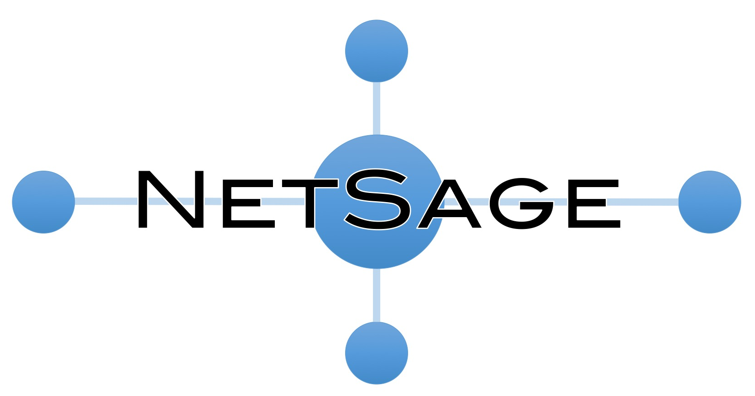
Joint project with UC Davis, ESnet and U. Hawaiʻi
Open, privacy-aware, network measurement, analysis, and visualization service
Designed to address the needs of today’s international networks
Active and passive measurements over IRNC Backbones and Exchange Points
Focus on privacy issues
Longitudinal network data visualization services

Slide 3
3 NetSage use cases
Current traffic patterns across IRNC links, and the ability to anticipate growth trends for capacity-planning purposes;
The main sources and sinks of large, elephant flows to know where to focus outreach and training opportunities; and
Where packet loss is occurring, whether the cause is congestion or other issues, and what impact it has on end-to-end performance.

Slide 4
Privacy
Privacy is a top concern for many people
Our plan is that we do not store any PII to long term storage ever
Data collected that potentially has PII in it will be collected as close to the source as possible (such as a server directly attached to the router it is receiving it from)
Data will be anonymized, aggregated and/or meta-tagged as appropriate before it is sent back to the central store over an encrypted connection
We are forming a privacy committee consisting of people who are not directly part of the grant to advise us on privacy issues

Slide 5
Data we’re collecting
Active measurements using PerfSONAR
Throughput, loss, latency, and traceroute data
Passive measurements
SNMP and (later) NetFlow/sFlow data
(Later-er) More in-depth flow analysis including TCP retransmit analysis from Bro
Also hope to integrate alarm data from the IRNC NOC
Data Anonymized to meet privacy concerns

Slide 6
Questions/Comments?
Take aways:
Privacy
Utility
Cool looking
Group Website:
http://internationalnetworking.indiana.edu/
Jennifer Schopf – jmschopf@indiana.edu
Andrew Lee – leea@indiana.edu

